Slide 1

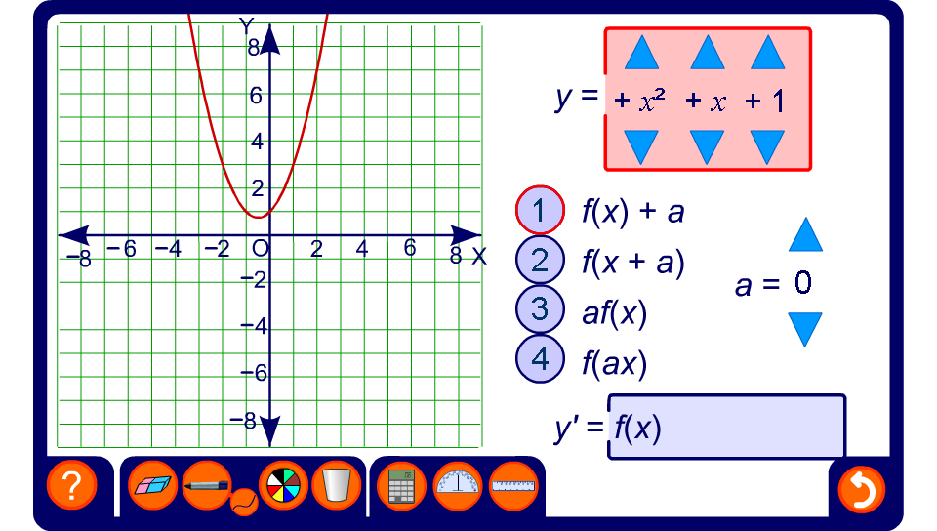


Transforming quadratic functions
Notes:
Use this activity to investigate a variety of transformations applied to quadratic functions.

